Slide 1

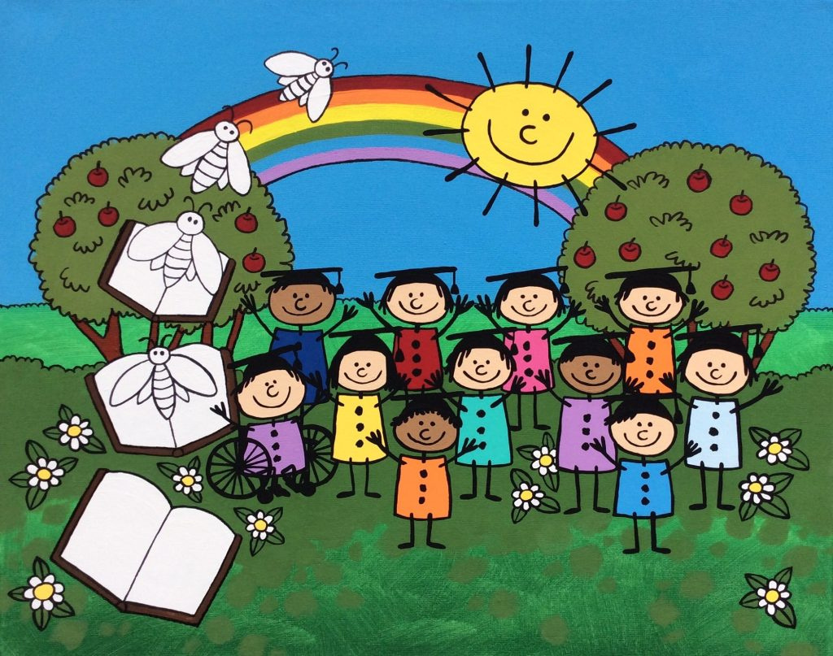
ON OUR WAY TO K!
PARENT INFORMATION SESSION
FALL 2026

Slide 2
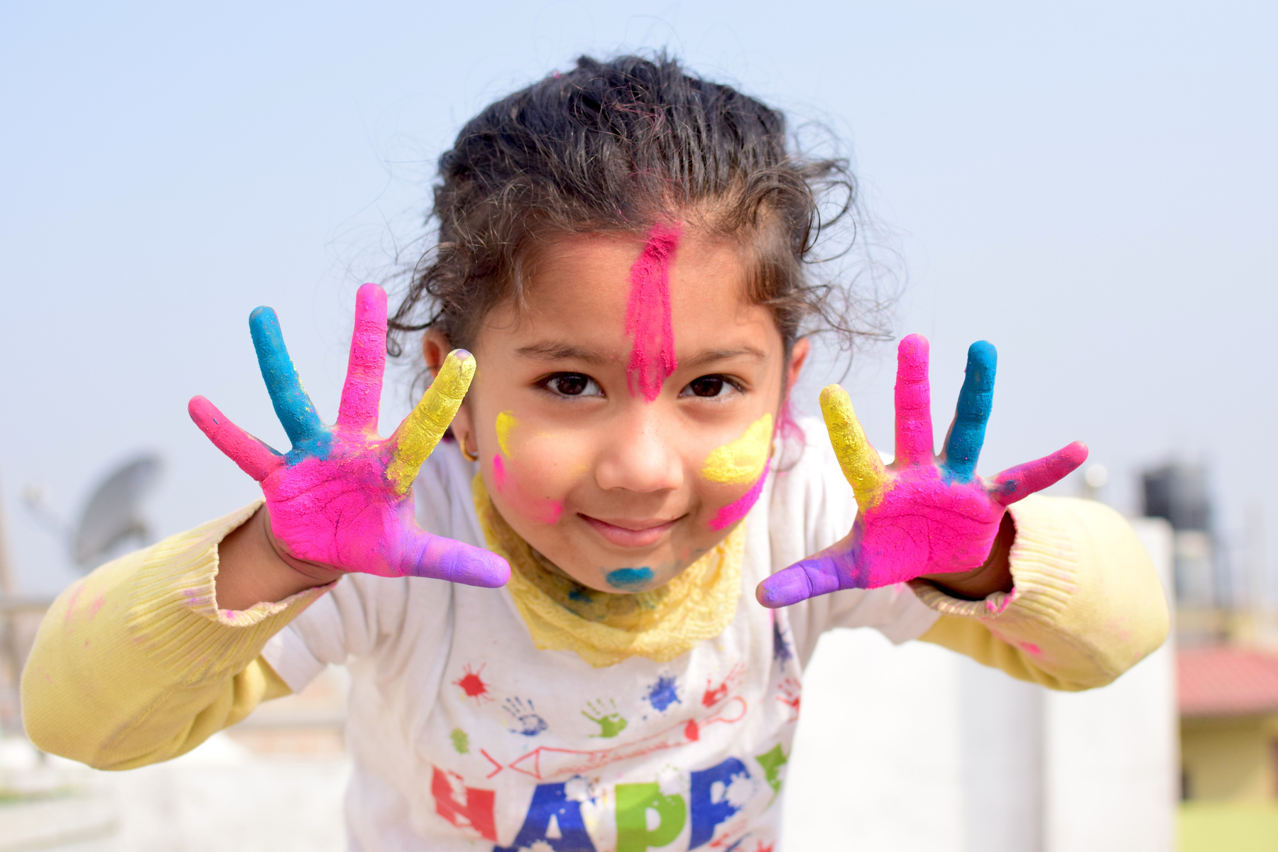

PURPOSE OF THIS INFORMATION
To provide you with an opportunity to learn more about the transition to school - On Our Way To K! and the upcoming events.
AND
To share information to encourage your child’s love of learning as they get ready to go to Kindergarten.

Slide 3

TRANSITION TO KINDERGARTEN
ON OUR WAY TO K! 5-STEP PROCESS
1
Kindergarten Registration
2
Early Years Evaluation (EYE-DA)
3
Information for Parents/Guardians
4
School Visit #1
5
School Visit #2

Slide 4


DOCUMENTATION
PLEASE ENSURE THAT YOU HAVE PROVIDED THE REQUIRED REGISTRATION INFORMATION TO THE STUDENT WELCOME CENTRE:
Child’s Birth Certification
Child Medicare Card
Child’s Immunization Records
Proof of Residency (copy of phone/power bill, etc.)
ASD-E

Slide 5

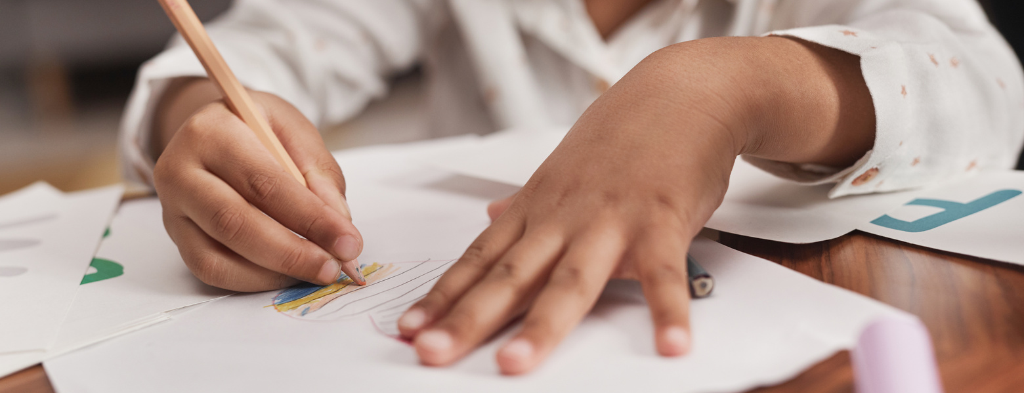
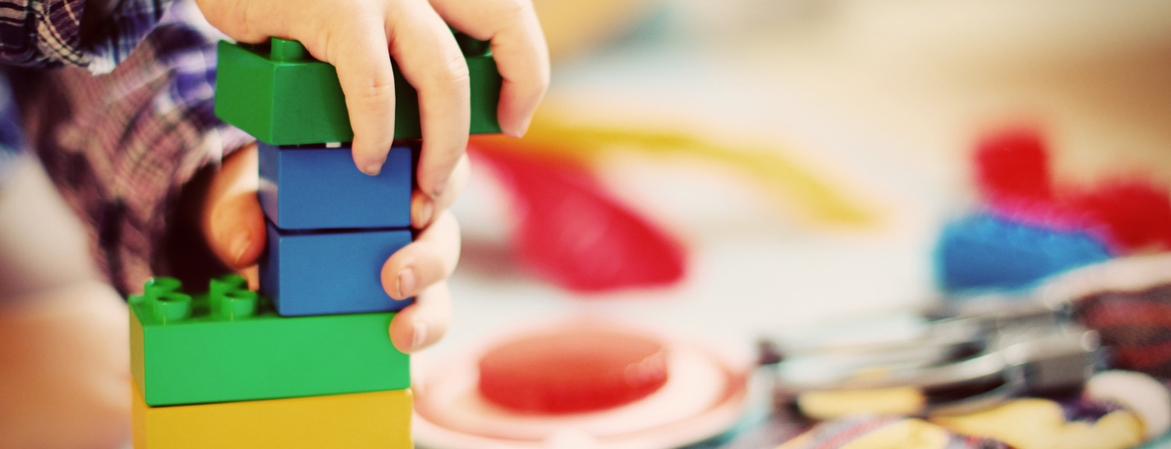
STEP 2
The Early Years Evaluation - Direct Assessment is an assessment administered one-on-one with children soon to enter Kindergarten.
EARLY YEARS EVALUATION - DIRECT ASSESSMENT (EYE-DA)
The EYE-DA takes approximately 45 minutes per child.
Colourful pictures and physical activities makes the EYE-DA fun for children.
Parents sit with their children during the EYE-DA and will receive the results and additional information during the appointment.

Slide 6



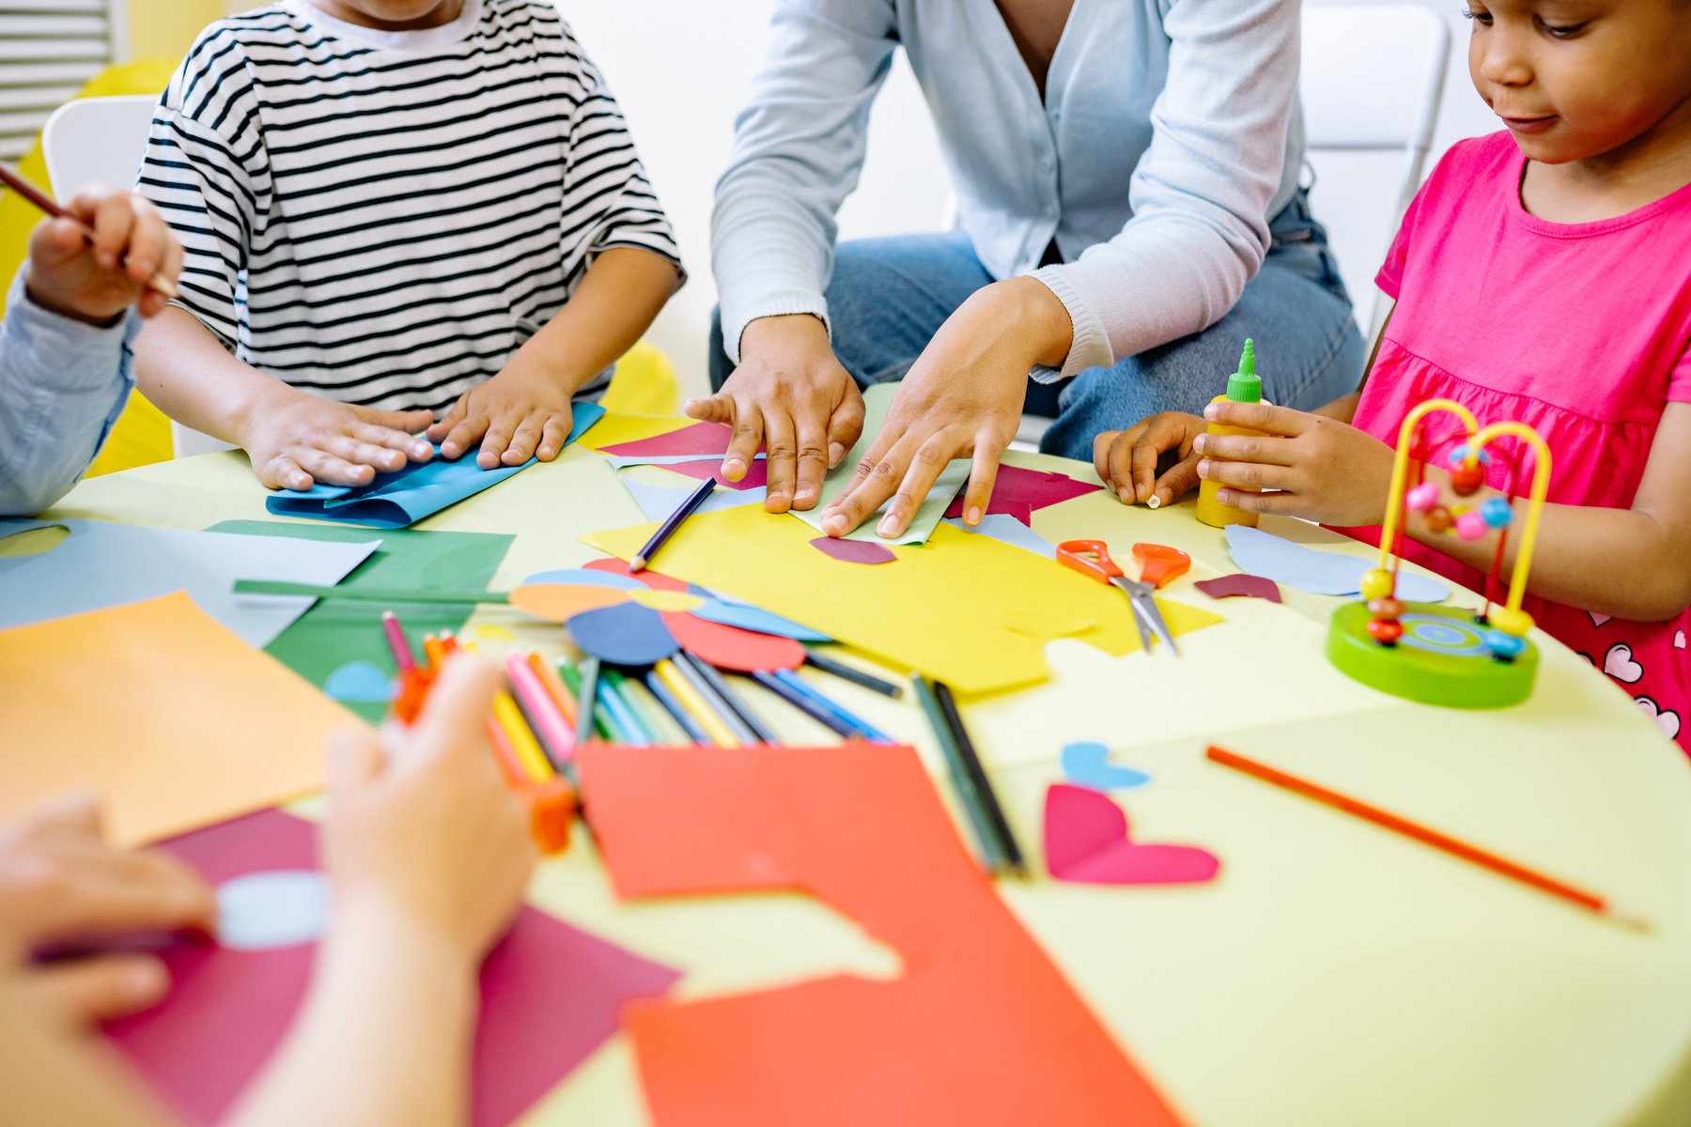
WHAT DOES THE EYE-DA ASSESS?
THE EYE-DA ASSESSES FOUR KEY AREAS OF A CHILD’S DEVELOPMENT:
Awareness of Self and Environment
Cognitive Skills
Language and Communication
Physical Development
e.g. knowing what a police officer does, knowing colors, opposites, etc.
e.g. knowing rhymes, some letters, etc.
e.g. speaking full sentences, understanding instructions, etc.
e.g. using crayons, scissors, hopping on one foot, etc.

Slide 7
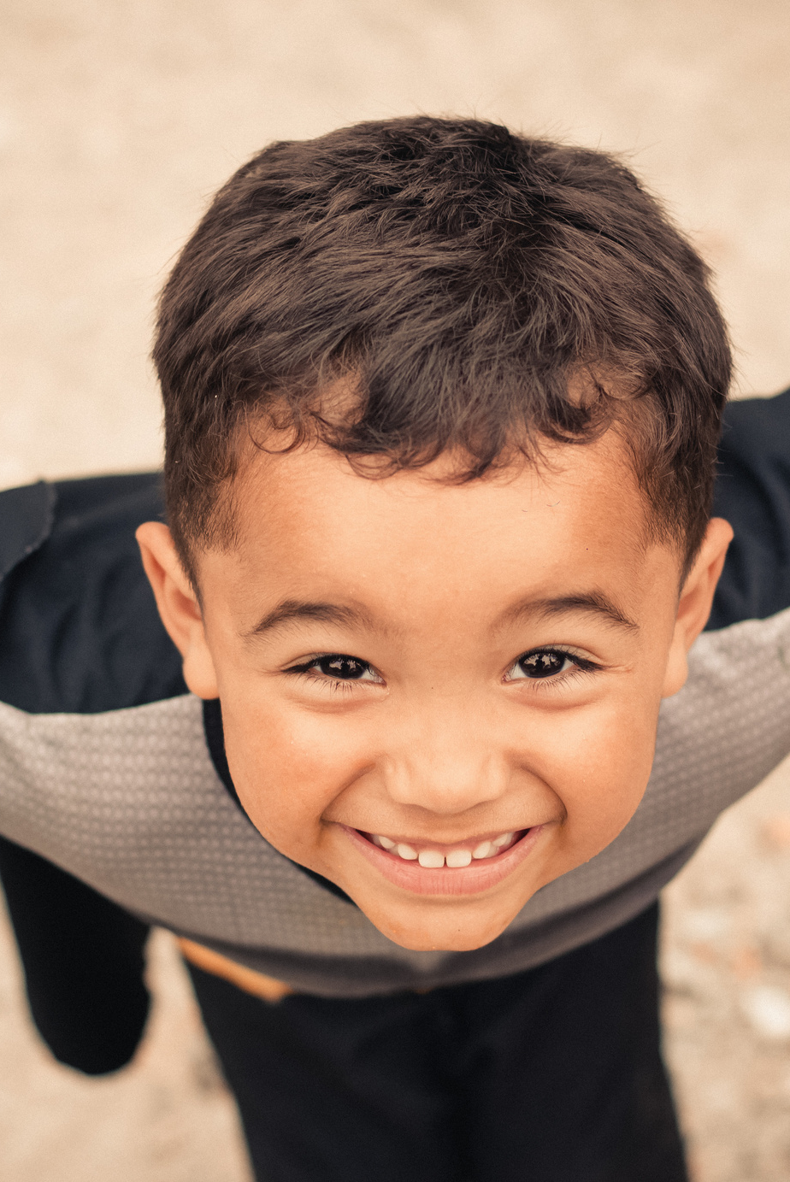




EYE-DA RESULTS
After the EYE-DA is complete, parents will receive their child’s results immediately.
Results are presented using the color codes described below:
[Green]
Appropriate development
[Yellow]
Experiencing some difficulty
[Red]
Experiencing significant difficulty
/
NOT COMPLETE
Not complete (child did not complete enough items in the domain to generate a result).

Slide 8
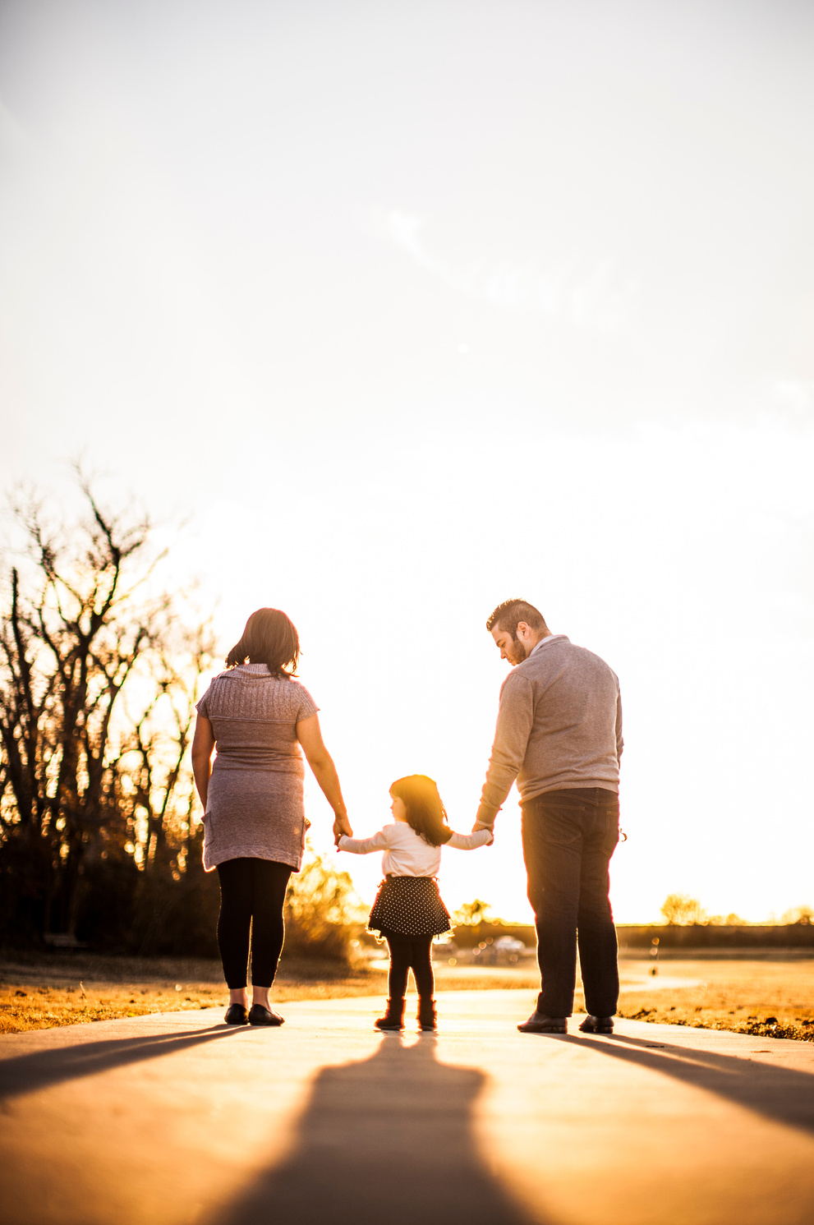
THE EYE-DA IS USED TO:
Assess areas of strength, and areas yet to be developed;
Identify children who may require additional resources;
Support a positive transition to school; and,
Inform and involve parents/caregivers in meaningful ways.

Slide 9


STEP 3
WE’RE EXCITED TO HAVE YOU JOIN US FOR STEP 3 OF THE
ON OUR WAY TO K! PROCESS
INFORMATION FOR PARENTS AND GUARDIANS
Information sharing
Support and transition tips
This is an important step in supporting your child’s transition to kindergarten!

Slide 10

STEP 4
SCHOOL VISIT #1
This visit offers children and their parents a brief opportunity to spend time in their future school with peers and kindergarten teachers. Children will be invited to take part in activities with their parent.
Invitations will be sent to you by the school and posted on the ASD-E website.
This visit typically occurs in February or March.

Slide 11

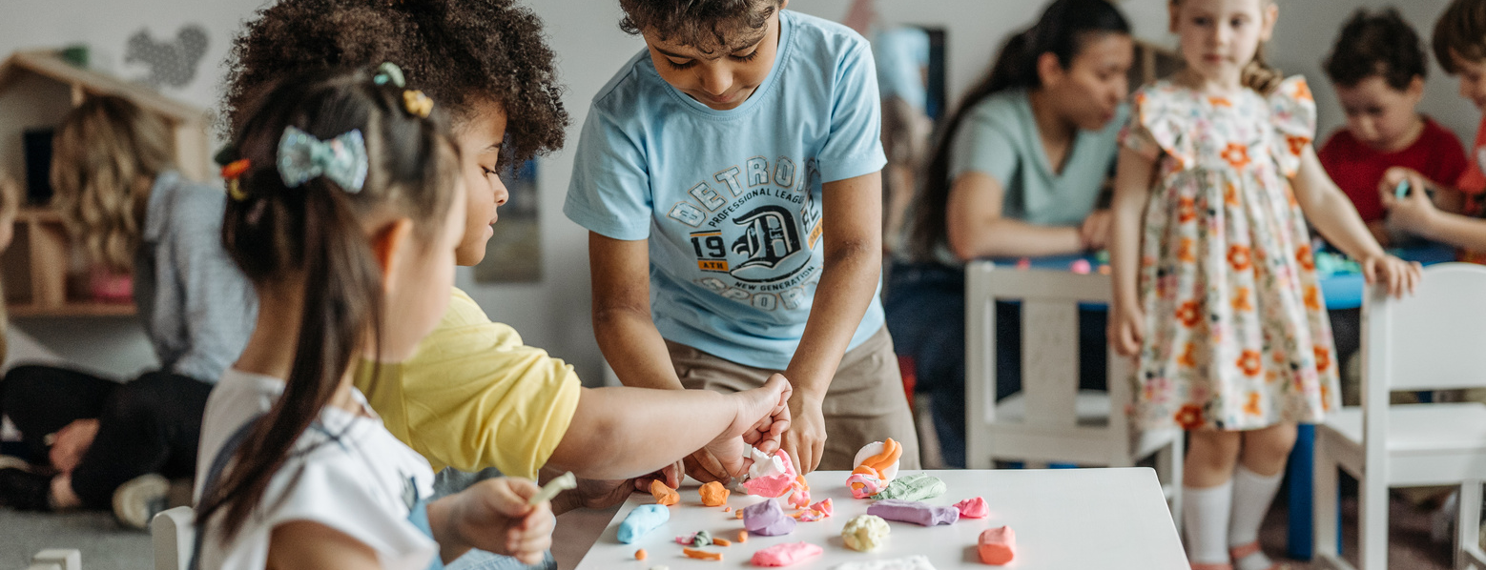
STEP 5
SCHOOL VISIT #2
This visit lets children spend part of a day in a kindergarten classroom, experiencing school activities and meeting future classmates and teachers.
Parents/guardians will spend time with the principal being informed of specific school-related details.
Invitations will be sent to you by the school and dates will be posted on the ASD-E website.
This visit typically occurs in April or May.
During this visit, you and your child will enjoy a short ride on a school bus!

Slide 12

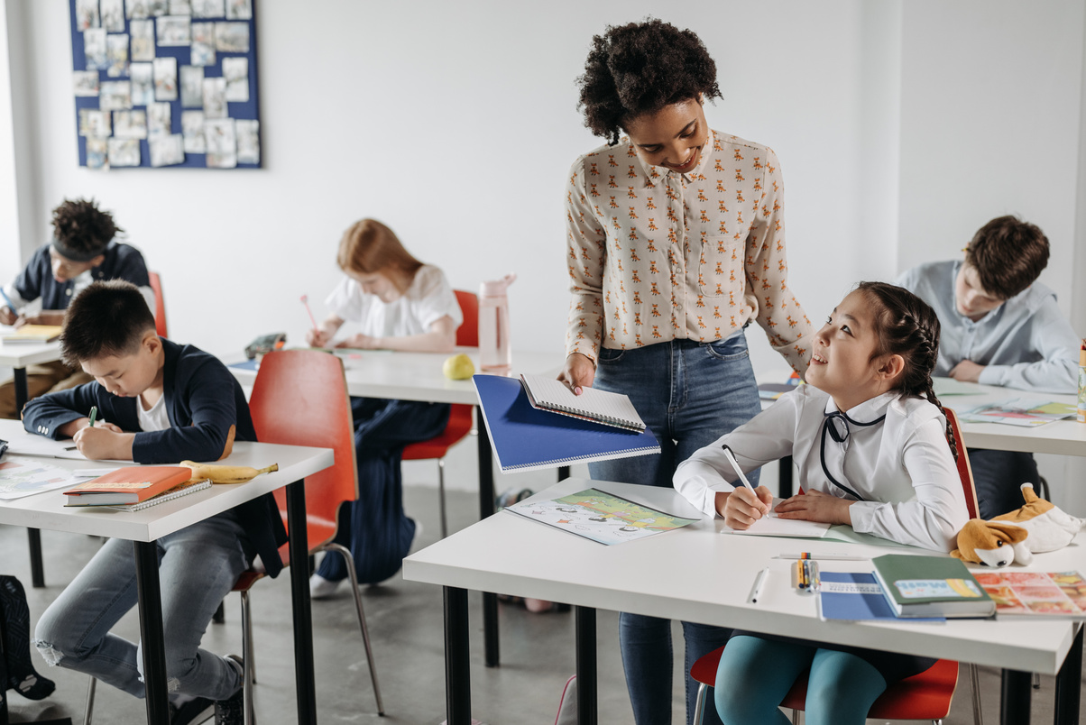
PARENT/GUARDIAN - SCHOOL PARTNERSHIP
A child’s formal education begins in kindergarten, but learning begins at birth.
Parents/Guardians are their child’s first teacher and know their child best.
A positive partnership between parents and school contributes to positive outcomes for children.

Slide 13
TRANSITION TIPS & SUGGESTIONS
Provide your child with independence in self-help skills, such as washing their hands, toileting, and dressing
Visit the school playground
Talk about what to expect at school, and discuss any fears
Attend the On Our Way To K! events.
Starting school is not about...
knowing the alphabet
knowing how to read and write
being able to sit at a table for long periods of time

Slide 14


PREPARING FOR THE SCHOOL ENVIRONMENT
Helpful skills to ease the transition
Name recognition
Can ask for help
Open lunch containers
Tries to self-regulate &
articulate feelings in words
Can follow simple directions
Toileting independently
Zipping jacket
Getting dressed

Slide 15

YOUR CHILD NEEDS THE OPPORTUNITY TO:
Sing songs
Tell stories
Create
Play
Be curious & ask questions
Read
Hear rich vocabulary
Make mistakes
Have a loving caregiver
Connect with others
Be independent

Slide 16
THANK YOU
FOR YOUR PARTNERSHIP WITH THE TRANSITION TO KINDERGARTEN
We look forward to meeting your child!

